Slide 1
Volleyball Scouting using Databases
By Robin Stragier

Slide 2
Introduction to the Project

Slide 3

Practical Sidenotes:
My apologies for going over the 5 minutes
Due to privacy complaints, only one match could be filmed
Method deferred from original claims
  Goal stayed the same: using a database for scouting purposes
  Original method: using neural networks to calculate ball position
  Used method: manual estimation

Slide 4
Manual Estimation
SIDE OUT 2
S I D E O U T 1 | 1 | 2 | 3 | 4 | 5 | 6 | 7 | 8 | 9 | S I D E O U T 3
 | 10 | 11 | 12 | 13 | 14 | 15 | 16 | 17 | 18
 | 19 | 20 | 21 | 22 | 23 | 24 | 25 | 26 | 27
 | 28 | 29 | 30 | 31 | 32 | 33 | 34 | 35 | 36
 | 37 | 38 | 39 | 40 | 41 | 42 | 43 | 44 | 45
 | 46 | 47 | 48 | 49 | 50 | 51 | 52 | 53 | 54
 | 55 | 56 | 57 | 58 | 59 | 60 | 61 | 62 | 63
 | 64 | 65 | 66 | 67 | 68 | 69 | 70 | 71 | 72
 | 73 | 74 | 75 | 76 | 77 | 78 | 79 | 80 | 81
Over/In Net
Diving Playing field in squares
1m² per square
Using present lines on field to
Find the position of the player
Playing the ball

Slide 5
Manual Estimation
SIDE OUT 2
S I D E O U T 1 | 1 | 2 | 3 | 4 | 5 | 6 | 7 | 8 | 9 | S I D E O U T 3
 | 10 | 11 | 12 | 13 | 14 | 15 | 16 | 17 | 18
 | 19 | 20 | 21 | 22 | 23 | 24 | 25 | 26 | 27
 | 28 | 29 | 30 | 31 | 32 | 33 | 34 | 35 | 36
 | 37 | 38 | 39 | 40 | 41 | 42 | 43 | 44 | 45
 | 46 | 47 | 48 | 49 | 50 | 51 | 52 | 53 | 54
 | 55 | 56 | 57 | 58 | 59 | 60 | 61 | 62 | 63
 | 64 | 65 | 66 | 67 | 68 | 69 | 70 | 71 | 72
 | 73 | 74 | 75 | 76 | 77 | 78 | 79 | 80 | 81
Over/In Net

Slide 6
The Database
CONTACTS
Contact Index | Contact Type | Player | Area | Video | Timestamp
Playes
Player Number | First Name | Last Name | Position
VIDEO
Video Number | File Name | Set

Slide 7
The match

Slide 8
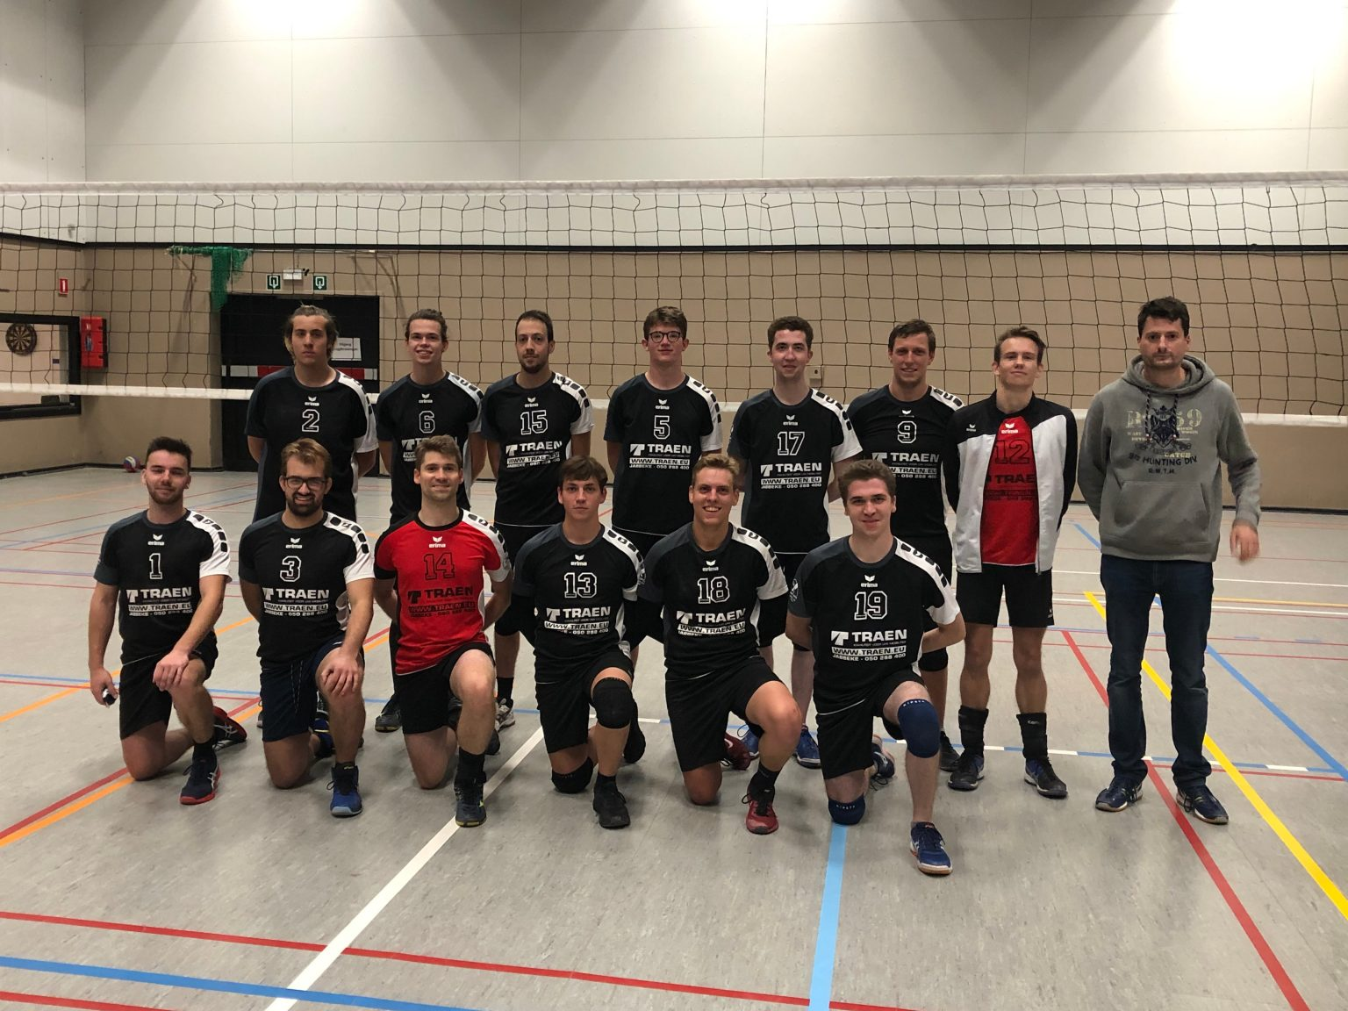
Davolo Heren

Slide 9
Key principle: number of contacts

Slide 10
The Analysis

Slide 11
The serve
2
0 | 0 | 0 | 0 | 0 | 0 | 0 | 0 | 0 | 0 | 2
 | 0 | 0 | 0 | 0 | 1 | 1 | 0 | 1 | 0
 | 0 | 1 | 2 | 3 | 5 | 3 | 2 | 2 | 0
 | 0 | 0 | 3 | 1 | 3 | 7 | 3 | 3 | 2
 | 0 | 2 | 1 | 2 | 0 | 1 | 0 | 1 | 0
 | 0 | 0 | 1 | 0 | 1 | 0 | 0 | 0 | 0
 | 0 | 0 | 0 | 0 | 0 | 0 | 0 | 0 | 0
 | 0 | 0 | 0 | 0 | 0 | 0 | 0 | 0 | 0
 | 0 | 0 | 0 | 0 | 1 | 0 | 0 | 0 | 0
2

Slide 12
The defense
0
0 | 0 | 0 | 0 | 0 | 0 | 0 | 0 | 0 | 0 | 0
 | 1 | 0 | 1 | 1 | 1 | 0 | 0 | 1 | 1
 | 1 | 2 | 1 | 2 | 5 | 4 | 0 | 1 | 0
 | 1 | 4 | 9 | 11 | 4 | 6 | 2 | 2 | 0
 | 0 | 5 | 8 | 3 | 4 | 6 | 3 | 4 | 0
 | 0 | 3 | 3 | 2 | 5 | 2 | 1 | 1 | 1
 | 0 | 2 | 5 | 2 | 0 | 2 | 3 | 3 | 0
 | 1 | 2 | 1 | 2 | 1 | 1 | 4 | 0 | 0
 | 0 | 5 | 0 | 0 | 2 | 0 | 2 | 2 | 1
0

Slide 13
The pass
3
6 | 0 | 0 | 0 | 0 | 0 | 0 | 0 | 0 | 0 | 3
 | 0 | 0 | 1 | 0 | 0 | 0 | 1 | 0 | 0
 | 0 | 1 | 0 | 0 | 0 | 0 | 1 | 0 | 0
 | 0 | 1 | 1 | 0 | 0 | 0 | 0 | 0 | 0
 | 1 | 1 | 0 | 0 | 0 | 1 | 1 | 0 | 1
 | 0 | 2 | 2 | 0 | 8 | 2 | 0 | 2 | 0
 | 1 | 0 | 6 | 4 | 4 | 0 | 1 | 0 | 0
 | 0 | 2 | 10 | 7 | 5 | 3 | 1 | 0 | 1
 | 2 | 6 | 14 | 10 | 8 | 6 | 2 | 1 | 0
1

Slide 14
The spike
0
0 | 0 | 0 | 0 | 0 | 0 | 0 | 0 | 0 | 0 | 5
 | 0 | 0 | 0 | 0 | 0 | 0 | 0 | 0 | 0
 | 0 | 0 | 0 | 0 | 0 | 0 | 0 | 0 | 0
 | 0 | 0 | 1 | 1 | 1 | 0 | 0 | 0 | 0
 | 0 | 0 | 1 | 0 | 0 | 0 | 0 | 1 | 0
 | 0 | 2 | 1 | 0 | 0 | 0 | 1 | 3 | 1
 | 2 | 1 | 0 | 0 | 0 | 0 | 3 | 1 | 2
 | 2 | 4 | 2 | 0 | 0 | 0 | 0 | 3 | 3
 | 11 | 16 | 5 | 4 | 2 | 0 | 0 | 14 | 24
0

Slide 15
The spike: continued
2
2 | 0 | 0 | 0 | 0 | 0 | 0 | 0 | 0 | 0 | 3
 | 0 | 0 | 1 | 0 | 0 | 0 | 0 | 1 | 0
 | 1 | 4 | 4 | 2 | 3 | 1 | 1 | 2 | 1
 | 0 | 1 | 2 | 4 | 3 | 0 | 2 | 5 | 4
 | 0 | 2 | 1 | 2 | 5 | 2 | 2 | 1 | 1
 | 0 | 2 | 3 | 1 | 2 | 0 | 0 | 2 | 0
 | 0 | 2 | 2 | 3 | 2 | 1 | 1 | 1 | 0
 | 2 | 1 | 1 | 1 | 1 | 1 | 1 | 0 | 0
 | 0 | 1 | 2 | 0 | 1 | 0 | 1 | 1 | 0
0

Slide 16
The individual player
0
1 | 0 | 0 | 0 | 0 | 0 | 0 | 0 | 0 | 0 | 1
 | 0 | 0 | 0 | 0 | 0 | 0 | 0 | 0 | 0
 | 1 | 0 | 1 | 1 | 0 | 1 | 1 | 1 | 0
 | 0 | 2 | 0 | 1 | 1 | 1 | 2 | 1 | 0
 | 1 | 1 | 1 | 1 | 2 | 0 | 0 | 1 | 0
 | 0 | 2 | 3 | 0 | 7 | 0 | 0 | 0 | 0
 | 0 | 1 | 8 | 3 | 3 | 0 | 0 | 0 | 0
 | 0 | 2 | 8 | 8 | 5 | 2 | 1 | 0 | 0
 | 0 | 7 | 13 | 8 | 10 | 6 | 3 | 1 | 0
0

Slide 17
Thank you for your attention!
Has anyone any questions?
Video material and database data can be found on github:
https://...

